Slide 1
Banking in Europe: What went wrong, and how to fix it?
Boris Vujčić
e-mail: boris.vujcic@hnb.hr

Slide 2
Structure of the presentation
Overview of the European banking sector
Lending and asset quality
Capital and funding
Deleveraging
Banks and Sovereigns
Government intervention
Reform of the architecture – banking union
Single supervisory mechanism
Resolution mechanism and deposit guarantee scheme
View from a possible opt-in country: to join or not to join?

Slide 3
Credit activity across the Euro area
Loans to private sector in Euro area stagnated since the start of the financial crisis (cumulative nominal growth in five years amounted to 0.8%, meaning effective decrease).
However, huge differences among countries: stock of loans varies from 60% to 130% of the pre-crisis level – a number of member states experience serious credit crunch.

Slide 4
Overall - stagnation in lending, but large differences between the Euro zone countries
Cumulative credit growth 9.2008-7.2013
Source: ECB and CNB.

Slide 5
Banks’ assets structure and market disintegration in the euro area
Data on lending show that financial markets became increasingly fragmented.
Moreover, banks in Euro area increased share of domestic bonds holdings with the bulk of domestic bonds purchases referring to Government bonds.
Government bonds, on one hand, seemed like a reasonable (CAR supporting) investment in the period of high risk aversion, credit risk increase and low private sector demand.
However, such an increasing exposure towards domestic governments further strengthened the link between banks and sovereigns.

Slide 6
Increasing home (government) bias in Euro zone and Croatia
Domestic bonds to total bonds
Government Securities / (Government Securities + Loans to private sector)
Source: ECB.

Slide 7
Asset quality of European banks continuously declines
Non-performing loans continue to increase making value adjustment costs decrease unlikely.
Besides NPLs increase, value adjustment costs rise due to a need to further provision the existing NPLs.
US in a better shape.
In Croatia, NPL coverage is lower, but the proportion of recognized NPLs is higher comapred with peers.

Slide 8
Asset quality
Bank Non-performing loans ratio
Non-performing loans coverage
Source: IMF, FSI, (bank assets) weighted averages
Note: CEE countries: Bulgaria, Croatia, Czech Republic, Estonia, Hungary, Latvia, Lithuania, Poland, Romania, Slovak Republic, Slovenia

Slide 9
Bank performance
Bank earnings in Europe strongly affected by deteriorating assets while in US provisions are decreasing and, thus, even supporting the earnings. Accounting/provisioning standards?
Double impact of rising Non-performing loans: value adjustment costs increase and interest income decline.
US banks operating with lower operating profitability but with assets of higher quality, and with less leverage, have more credit potential.
Croatian banks fared well in most of the crisis period; however, prolonged recession started to weight in on the banks performance. Credit risk materialisation plays increasing role in banking with interest income starting to suffer.

Slide 10
Bank performance indicators
Bank Return on Assets
Bank Return on Assets excluding value adjustment costs
Source: IMF, FSI, (bank assets) weighted averages
Note: CEE countries: Bulgaria, Croatia, Czech Republic, Estonia, Hungary, Latvia, Lithuania, Poland, Romania, Slovak Republic, Slovenia

Slide 11
CAR in Europe relatively high, but also high leverage!?
United states traditionally has higher capital ratios.
CA ratios in Europe increased after the crisis mostly due to a risk aversion.
On the other hand, equity to un-weighted assets ratio remains stable (even decreased slightly in Euro zone after 2010) meaning that the fresh capital inflow in the banking sector has been scarce – there has been no deleveraging.
In Croatia, high capital buffers make banking sector much more resilient to the crisis and change of regulatory standards than elswhere.

Slide 12
CAR in Europe is improving, but without corresponding decline in leverage
Bank (regulatory) capital adequacy ratio (CAR)
Bank capital to un’weighted assets
Source: IMF, FSI, (bank assets) weighted averages
Note: CEE countries: Bulgaria, Croatia, Czech Republic, Estonia, Hungary, Latvia, Lithuania, Poland, Romania, Slovak Republic, Slovenia

Slide 13
Costs of financial aid in the EU 2008-2011: costly crisis
27 EU members approved around 4,656 billion Euro of financial aid to banking institutions (with 1,676 billion spent until the end of 2011).
United Kingdom, Germany, Denmark and Ireland approved more the 500 billion EUR while Bulgaria, Czech R, Estonia, Malta, Romania and Croatia did not provide any help to their banks.
Relative to 2011 GDP, highest bank support was provided by Ireland (328 %) and Denmark (258%) with Belgium and Netherlands commiting more than 50% of GDP as well.
The structure of EU-27 bank support shows that countries used mostly guarantees to support banks (27.3%) with recapitalization, buying of troubled assets and liquidity measures amounting to 4.9%, 3.6% and 1.7% of 2011 GDP respectively.

Slide 14
Costs of support to financial system 2008-2011
The amount of approved financial aid
The structure of approved financial aid
Source: European comission

Slide 15
Significant risks remain
Unlike in the USA, European banks’ capital is increasingly burdened with un-provisioned NPL’s.
Even without further NPL increase, resolving the current asset quality issue would take time and implies spending some buffers or gathering additional capital.
Two risks arise from the bank asset quality:
Fiscal risks arising from the NPL resolution
Dampening of the potential credit growth in the following years
In Croatia, higher burden of capital with NPLs is offset with high capital buffers. Even after correcting the capital ratio for the unprovisioned NPLs – Croatia has relativelly higher capital ratios.

Slide 16
Capital ratios are sensitive to NPL coverage
Capital ratios, End 2012
Source: IMF, FSI

Slide 17
European banks remain reliant on whole-sale funding (ECB)
Deposits of banks in the USA exceed their loans, with the LTD ratio decreasing continuously.
Euro area banks, on the other hand, even slightly increased their reliance on whole-sale funds (ECB).
CEE countries, started to deleverage in 2012. Before the crisis foreign liabilities share of total liabilities was relatively high due to high penetration of foreign banks.

Slide 18
With little new capital, euro area banks remain reliant on whole-sale funds (ECB)
Loan to deposit ratio
(Change of Equity) / Assets
Source: CNB and IMF - FSI, (bank assets) weighted averages
Note: CEE countries: Bulgaria, Croatia, Czech Republic, Estonia, Hungary, Latvia, Lithuania, Poland, Romania, Slovak Republic, Slovenia

Slide 19
CEE: unlike in the euro-area, higher LTDR – more deleveraging
Loan to deposit ratio
Change in banks' external debt between March 2013 and September 2008
Sources: CNB and national central banks.

Slide 20
Banking union
P. Romer: “A crisis is a terrible thing to waste”!
Incomplete supervisory architecture not the only (not even major) cause of the crisis, but crisis has laid ground for an integration of banking supervision in the Eurozone
not only in the form of common rules and practices, but also as an institutional integration of supervisory authorities.
BU becomes a necessary precondition (although not a sufficient one) of breaking the link between weak banks and weak sovereigns.

Slide 21
BU architecture

Slide 22
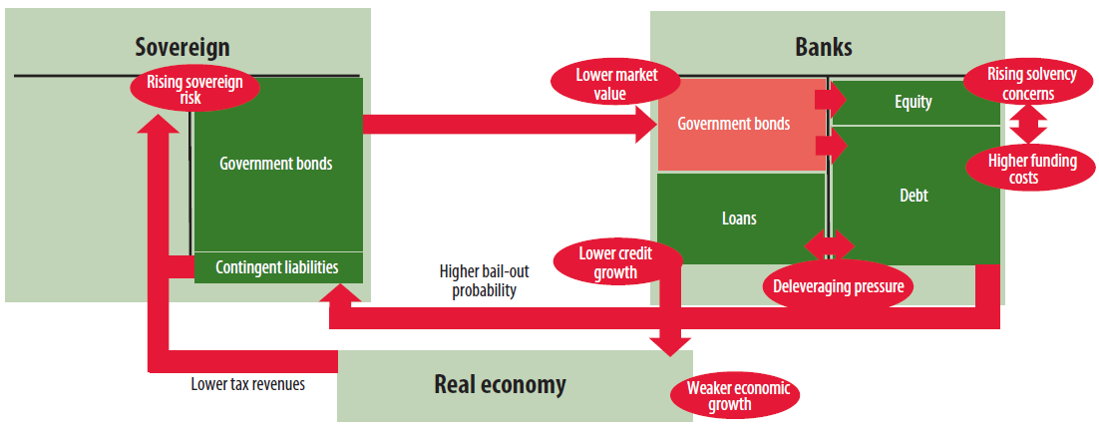
Link between weak banks and weak sovereigns
The contagion channel between sovereign and banks
IMF (2012), Global Financial Stability Report, April.

Slide 23
Single supervisory mechanism, banking union and the EU
Source: ECB.

Slide 24
BU advantages in general
Improving the regulatory framework
More effective supervision – timely intervention, less likely to be captured!
Common safety nets and backstops – breaking the link between banks and sovereigns
Together, these should eventually reduce social costs of financial crises
Harmonization of banking regulation and supervisory practices
Should improve the assessment of banks and banking systems
Less need for cross-border coordination
Reduced compliance costs
Benefits and costs of macro-prudential policies – internalized on union wide level
Potential to restrict ring-fencing activities

Slide 25
Advantages for non-euro countries?
Fostering of the financial integration
Providing better information on cross-border banks and improving their supervision
Streamlining some of the supervisory colleges
Ensuring greater consistency of supervisory practices
Avoiding distortions in the single-market

Slide 26
Challenges of SSM participation for non-euro area country
Participation in the decision making process - Serious efforts have been made to enhance participation of non-euro MS in decision making bodies, but some restrictions remain.
The final form of the banking union is still not known - We have almost 1½ of the 3 pillars agreed on the paper. Making a decision early is a leap into the unknown, one of the main risks being what future resolution of cross-border bank will look like.
Two different supervisory and bank resolution regimes may tilt the playing field and lead to competitive distortions - But, not even a single supervisory regime is likely to set the level playing fields as non-euro countries participate in SSM only.
26

Slide 27
Challenges of SSM participation for non-euro area country (2)
Accountability and potential costs are major issues - The decision is made within the SSM framework, but national authorities perform resolution and bear the costs.
SSM participation may impede the functioning of national macro-prudential policies.
ECBs lack of supervisory experience and the need to create institutional capacity for supervision or macro-prudential policies at the ECB level.
Subsidiaries operating in small states may get “under the radar”.
Just having a parent in the BU may help reap some of the benefits.
27

Slide 28
SSM timeline
Conduction of Asset Quality Review
The comprehensive assessment comprises three main components:
Risk Assessment System (RAS)
Balance Sheet Assessment (BSA)
→ „Targeted Asset Quality Review“
Joint Stress Test EBA and ECB

Slide 29
Balance Sheet Assessment

Slide 30
What about other two pillars?
The draft of Recovery and Resolution Directive was recently presented – although it has many sensible elements that will remove some uncertainty and strengthen market discipline, it leaves member states with much discretion, making competitive distortions likely.
Single supervision cannot work properly without an effective resolution authority and a credible financing mechanism. It also needs effective decision-making structures – all of which the SRM does not deliver at this point. Difficult political issue – Juncker: ‘We all know what to do, but don’t know how to go back home after that and get re-elected’
Deposit guarantee scheme - complicated legal and practical issues.
Pan-EU Deposit Guarantee Scheme? Member states use various schemes, so this would mean a longer-term project.

Slide 31
Deposit guarantee scheme harmonization
Credible DGS: appropriate coverage, timely payouts and adequately funded.
Harmonization among EU started after 2008 - Directive 2009/14/EC imposed the obligation to explore further elements of harmonization of DGS but set no timeline as regards its implementation.
Further harmonization of EU deposit guarantee schemes has been suspended pending the adoption of EU bank resolution arrangements through a new Directive.
However: The role of the deposit insurance agency varies widely, both within the EU and worldwide.
Lack of common EU funding standards:
Nominally, most of the countries have ex-ante (pre-funding) funding
Effectively, in many instances (i.e. in a case of systemic events) these are ex-post funding schemes since pre-funding is relatively modest.

Slide 32
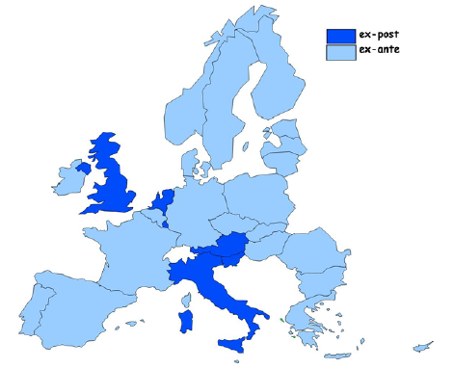
Differences in DGS among countries
Funding mechanisam for DGS
Insured deposits and DGS funds in some EU countries, End 2011
Notes: Eligible deposits is the sum of MFI household and corporate
deposits. Covered deposits applies the EC coverage ratio to eligible
deposits. * DGS or IMF staff info at end-2011, ** Banking associations top up the mandatory scheme, hence coverage ratio is lower bound
Source: European commision, JRC Report under Article
12 of Directive 94/19/EC
Source: IMF Country Report No. 13/66 Technical Note on Deposit Insurance
Insured deposits and DGS funds in Croatia, End 2012
Eligible deposits/GDP 0.86
Covered deposits/GDP 0.44
DGS fund size/GDP 1.21
Source: State agency for Deposit Insurance and bank
Rehabilitation, Croatian Bureau of Statistics

Slide 33
To conclude

Slide 34
To conclude
Setting up the BU will take time and effort.
Croatia is very supportive of setting up the BU, but the BU is currently set in such a way to increase the option value of waiting for non-euro member states.
Postponing the decision a bit doesn’t entail high costs, but making the decision now potentially does.
What could make SSM membership for non euro area members more attractive?
Access to resolution funds (use of BoP assistance could be a useful substitute) or liquidity assistance, level playing field when it comes to deposit insurance.
Overall, more complete BU is more attractive than an incomplete one!

Slide 35
Thank you!

