Slide 1
Asseco South Eastern Europe
“Banking system and the economy -
responses to the challenges of the crisis”
Miodrag Mirčetić
Board Member, ASEE
2.11.2012.
Belgrade, Serbia
Notes:
MK:
- pls move Solutions for Demanding Business on the bottom right corner, below web page address
logo: pls make thin stripe like in other pages, but a little bit lower, put blue Asseco SEE logo in the middle, and above logo blue line (we want to close logo between two lines)
Title lower

Slide 2
Asseco Group in the world
7th software company in Europe*
+15 000 employees
Diversified business profile
Concentrated on proprietary software and services
*According to Truffle100
Asseco Poland S.A. is the leader of the international Asseco Group
By acquiring companies from the Formula Systems IT group (Israel), gained access to worldwide markets (including the United States, Canada, Japan and Australia)

Slide 3
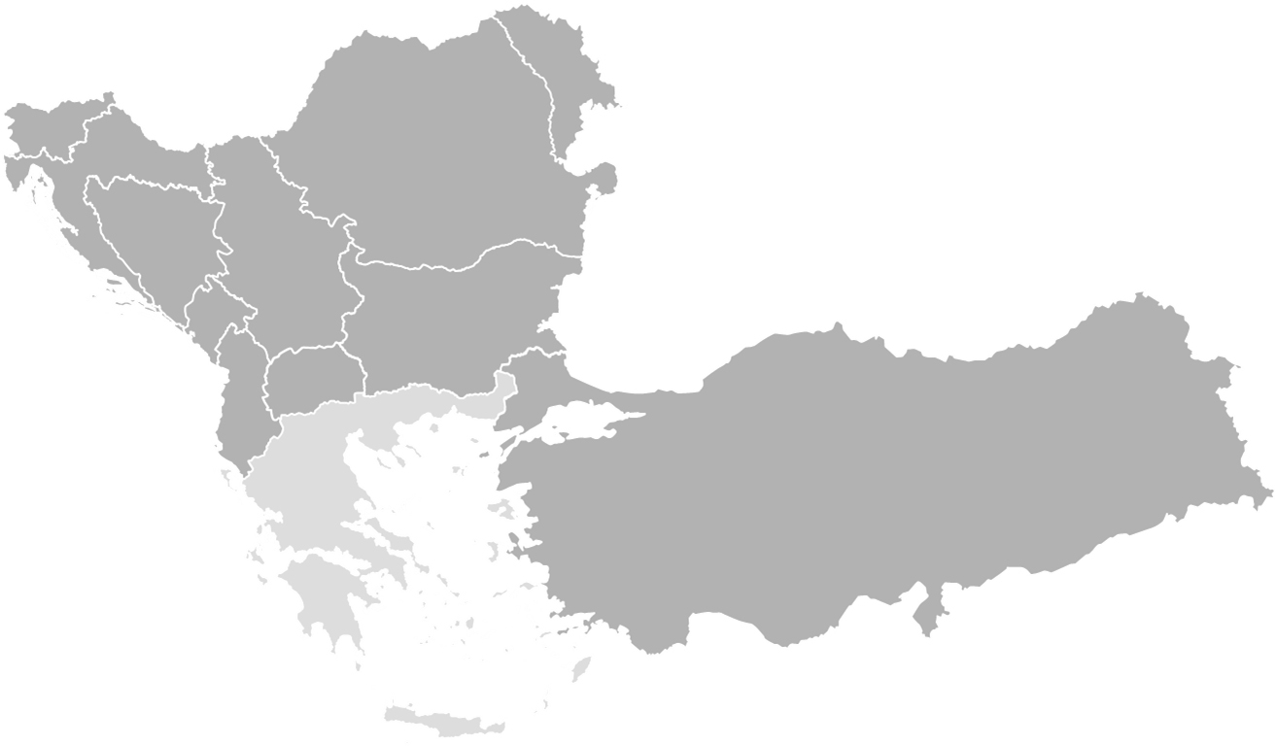
Asseco SEE Facts & Figures
Top player for banking in SEE, present in 11 countries and in 140+ banks
Ljubljana
Chisinau
Ljubljana
Zagreb
Bucharest
Sarajevo
Belgrade
Over 1,300 employees in the region
112 mEUR revenue in 2011
Podgorica
Sofia
Tirana
Skopje
Tirana
Ankara
Listed on Warsaw Stock Exchange since 2009
EBRD as a shareholder

Slide 4
Asseco SEE in Serbia – key facts
Solutions present in all banks in Serbia
23 banks in Serbia powered by ASEE core banking system
Exporting software solutions to banks in region
~500 employees
35 mEUR Revenue
Beside banking, present in public sector through projects with Tax Adminisrtation, Ministry of Interior RS, Serbian Armed Forces, Custom Administration, etc.

Slide 5
“Banking system and the economy -
responses to the challenges of the crisis”
Institutional support for IT use aimed at increased business efficiency
Questions
to discuss
Institutional support for regional business cooperation

